Slide 1
Geomapping Crashes in Washington DC GW Data Analytics Bootcamp Project 1
Amanda Walker
Jennifer P.
Kaori Niina
Maggie Leeker

Slide 2

Research Questions:
W

Slide 3
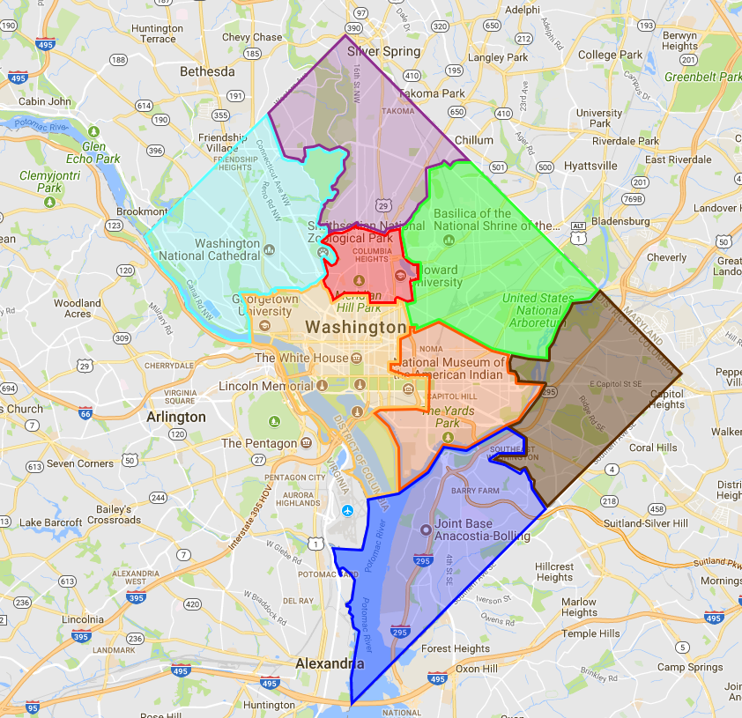
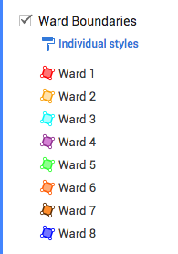
DC Wards Map

Slide 4
DC City Center: Most Accidented Neighborhood

Slide 5
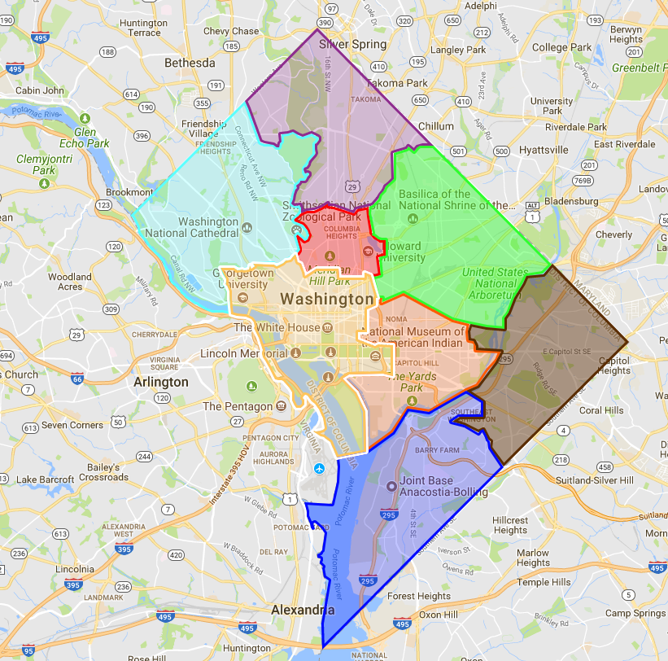
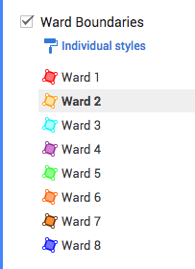
Ward 2: Let’s Deep Dive

